Slide 1








Slide 2
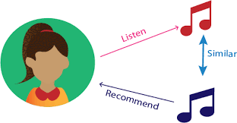


PROJECT ON: MUSIC RECOMMENDATION SYSTEM
PRESENTED BY:
MD ZEESHAN ARIF
AMIT KUMAR YADAV
MEHUL KHANDELWAL
MANAN PAREEK
JAIMIN MAKWANA

Slide 3
About us:
MD ZEESHAN ARIF:
completed my BE from mechanical engineering in the year 2016 from Annamalai university
since I was at the saturation state in my previous role, and I love working with data and statistics.
work experience of almost 3 years in mechanical domain and almost 4 months of experience in
data science as an intern
In my view INNOMATICS RESEARCH LAB provides an ultimate knowledge which can overtake any
other educational institute in India. They have such good faculties whose knowledge are quite
good.
And I would love to show my immense thanks to MR KANAV BANSAL for giving his knowledge
which really gonna help me out in data science career. Thanks to the whole team of INNOMATICS.

Slide 4
Table of contents:
ABOUT RECOMMENDATION SYSTEM
APPLICATION OF RECOMMENDATION SYSTEM
TYPES OF RECOMMENDATION SYSTEM
HOW RECOMMENDATION WORKS?
TECHNIQUES OF RECOMMENDATION
a) collaborative filtering
b) content based filtering
6) REFERENCES

Slide 5
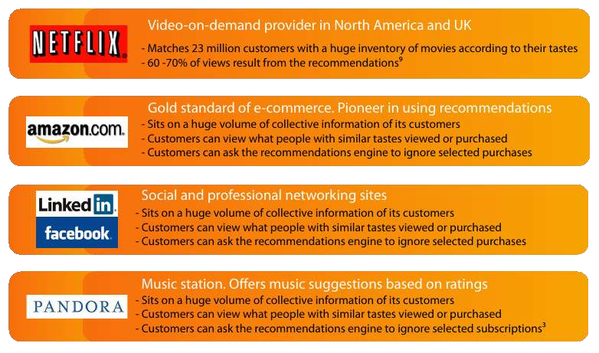
What is a Recommmendation System?
Recommendation system is an information filtering technique, which provides users with information, which he/she may be interested in.
Examples:

Slide 6

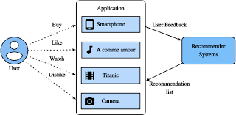
Areas of Use

Slide 7

Why there is a need?
“Getting Information off the internet is like taking a drink from a fire hydrant” - Mitchell Kapor
Information Overload
User Experience
Revenues
Recommender systems help in addressing the information overload problem by retrieving the information desired by the user based on his or similar users' preferences and interests.

Slide 8
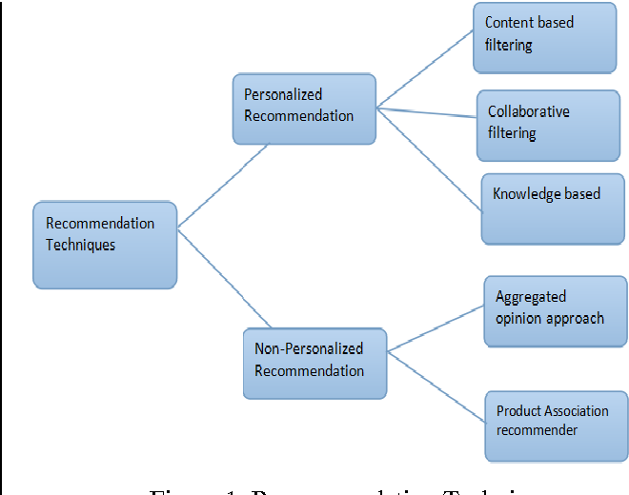
Types of Recommend system:

Slide 9
Techniques : Data Acquisition
Explicit Data
Customer Ratings
Feedback
Demographics
Physiographics
Ephemeral Needs
Implicit Data
Purchase History
Click or Browse History

Slide 10
Techniques : Recommendation Generation
Collaborative Filtering method finds a subset of users who have similar tastes and preferences to the target user and use this subset for offering recommendations.
Basic Assumptions :
Users with similar interests have common preferences.
Sufficiently large number of user preferences are available.
Main Approaches :
User Based
Item Based

Slide 11
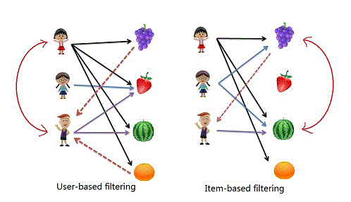
Amazon’s Item-to-Item CF
Difference with User and Item based CF

Slide 12
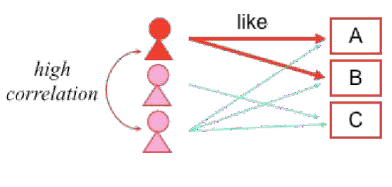
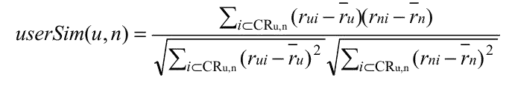
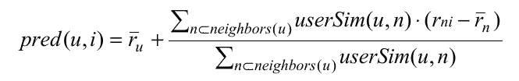
Techniques : Recommendation Generation
User-Based Collaborative Filtering
Use user-item rating matrix
Make user-to-user correlations
Find highly correlated users
Recommend items preferred by those users
Pearson Correlation :
Prediction Function :

Slide 13

Techniques : Recommendation Generation
User Based Collaborative Filtering
User
 | Item | I1 | I2 | I3 | I4 | I5
U1 |  | 5 | 8 |  | 7 | 8
U2 |  | 10 |  | 1
U3 |  | 2 | 2 | 10 | 9 | 9
U4 |  |  | 2 | 9 | 9 | 10
U5 |  | 1 | 5 |  |  | 1
User a 2 |  |  |  | 9 10
Recommend items preferred by highly correlated user U3 I5

Slide 14
Techniques : Recommendation Generation
User Based Collaborative Filtering
Advantage :
No knowledge about item features needed
Problems :
New user cold start problem
New item cold start problem: items with few rating cannot easily be recommended
Sparsity problem: If there are many items to be recommended, user/rating matrix is sparse and it hard to find the users who have rated the same item.
Popularity Bias: Tend to recommend only popular items.

Slide 15
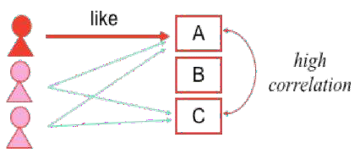
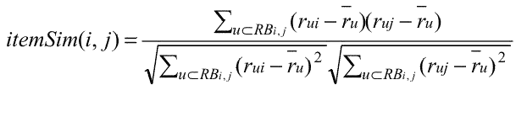
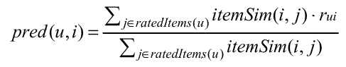
Item Based Collaborative Filtering
Use user-item ratings matrix
Make item-to-item correlations
Find items that are highly correlated
Recommend items with highest correlation
Similarity Metric :
Prediction Function :

Slide 16



Techniques : Recommendation Generation
Item Based Collaborative Filtering
Item
I1
I2
I3
Item I
I5
User
U1 | 5 | 8 |  | 7 | 8
U2 | 10 |  | 1
U3 | 2 |  | 10 | 9 | 9
U4 |  | 2 | 9 | 9 | 10
U5 | 1 | 5 |  |  | 1
User a | 2 |  | 9 | 10
Recommend items highly correlated to preferred items I5

Slide 17
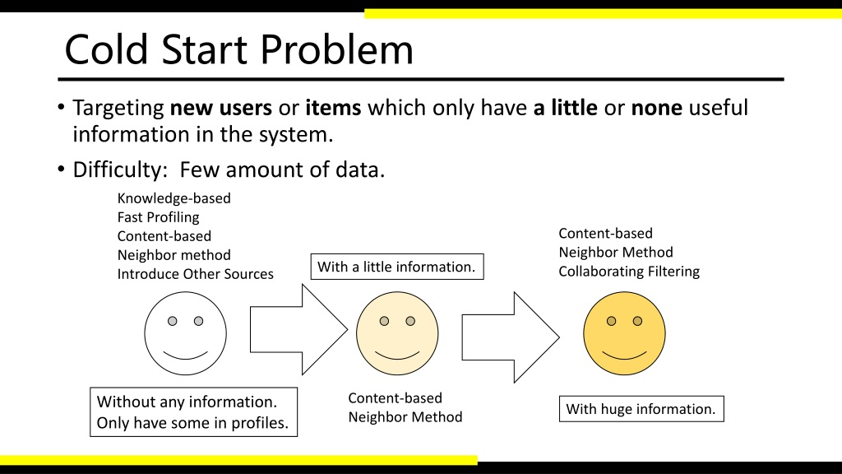
Cold start problem:
Cold start is a potential problem in computer-based information systems which involves a degree of automated data modelling.
Specifically, it concerns the issue that the system cannot draw any inferences for users or items about which it has not yet gathered sufficient information.

Slide 18
Collaborative recommendation
Item Based Collaborative Filtering
Advantages :
No knowledge about users features needed
Better scalability, because correlations between limited number of items instead of very large number of users
Reduced sparsity problem
Problems :
New user cold start problem
New item cold start problem
e.g. Amazon, eBay

Slide 19
Techniques : Recommendation Generation
2. Content Based Systems recommend items similar to those a user has liked (browsed/purchased) in the past.
OR
Recommendations are based on the content of items rather on other user's opinion.
User Profiles: Create user profiles to describe the types of items that user prefers.
e.g. User1 likes sci-fi, action and comedy.
Recommendation on the basis of keywords are also classified under content
based.

Slide 20
Content Based Systems Cont'd...
Advantages:
No need for data on other users. No cold start and sparsity.
Able to recommend users with unique taste.
Able to recommend new and unpopular items.
Can provide explanation for recommendation.
Limitations:
Data should be in structured format.
Unable to use quality judgements from other users.

Slide 21
REFERENCES:
You tube link: https://www.youtube.com/playlist?list=PLHgxf_dxCi34wefcq8UBsKaN_9fWhvqsX
Research paper reference: https://www.researchgate.net/publication/277714802_A_Survey_of_Music_Recommendation_Systems_and_Future_Perspectives
Book: https://drive.google.com/file/d/1n2tB4w9B14lbvg1vopcOgSniDnz-LVRI/view?usp=sharing

Slide 22


THANKS
TO
( INNOMATICS RESEARCH LAB )

